Slide 1
Battery facts, Carbon footprint & the world
The Global battery market will reach a whopping $86.6 billion in 2018!
Lead-acid still rules
We still mine nearly 5 million tonnes of lead ore
per year (latest figures)
Lithium-Ion batteries are still expensive
12V lead-based batteries will still be essential mass-market system for the foreseeable future
700 million Lead acid batteries are produced worldwide every year
700 million opportunities
70 million of those are made in Europe
If battery not charged, will need replacement within two years or less
Battery balance is equal if not more important as battery maintenance charging

Slide 2
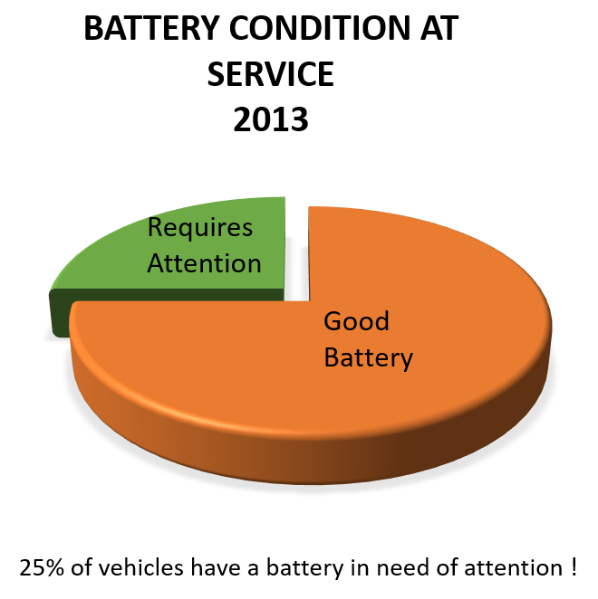
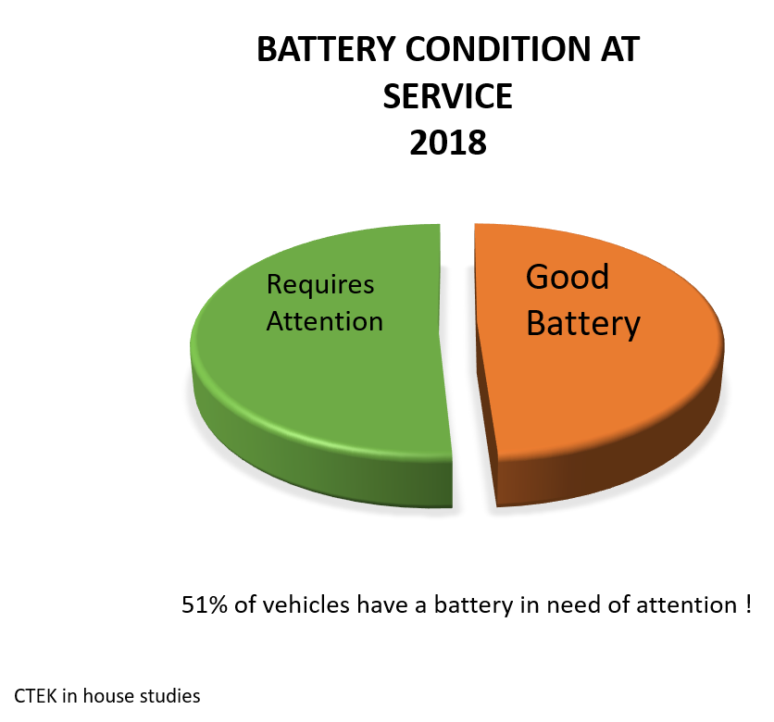
Why Balance
*Studies made by CTEK Battery chargers

Slide 3
“Snapshot analysis”
Sector | Total Tests | Good | Good Recharge | Charge & Retest | Replace | Bad Cell | %Requiring attention
Bus Fleet | 2497 | 1273 | 692 | 212 | 283 | 36 | 49%
Commercial Rental Fleet | 1952 | 1587 | 78 | 31 | 251 | 5 | 19%
Fire Service | 319 | 197 | 46 | 15 | 61 | 0 | 38%
Commercial OEM | 388 | 226 | 69 | 3 | 89 | 1 | 42%
Aftermarket Workshop | 867 | 299 | 420 | 24 | 118 | 6 | 66%
Body Shop | 100 | 23 | 24 | 10 | 43 | 0 | 77%
Totals | 6123 | 3605 (59%) | 1329 (22%) | 295 (4%) | 845 (14%) | 48 (1%) | 41%
The above data has been taken from a number of workshop industries as a ”snapshot” of the issues affecting Battery care & maintenance over 3 months
41% of all batteries tested required some sort of attention*
*Figures provided by Rotronics

Slide 4
Battery performance and balance, over time
Over an period of 1 year - 1,9 mio battery tests has been performed in segments which shows, battery performance segmented in percentage including in-and-out of balance
Data supplied by the ROBIS System - Rotronics UK

Slide 5
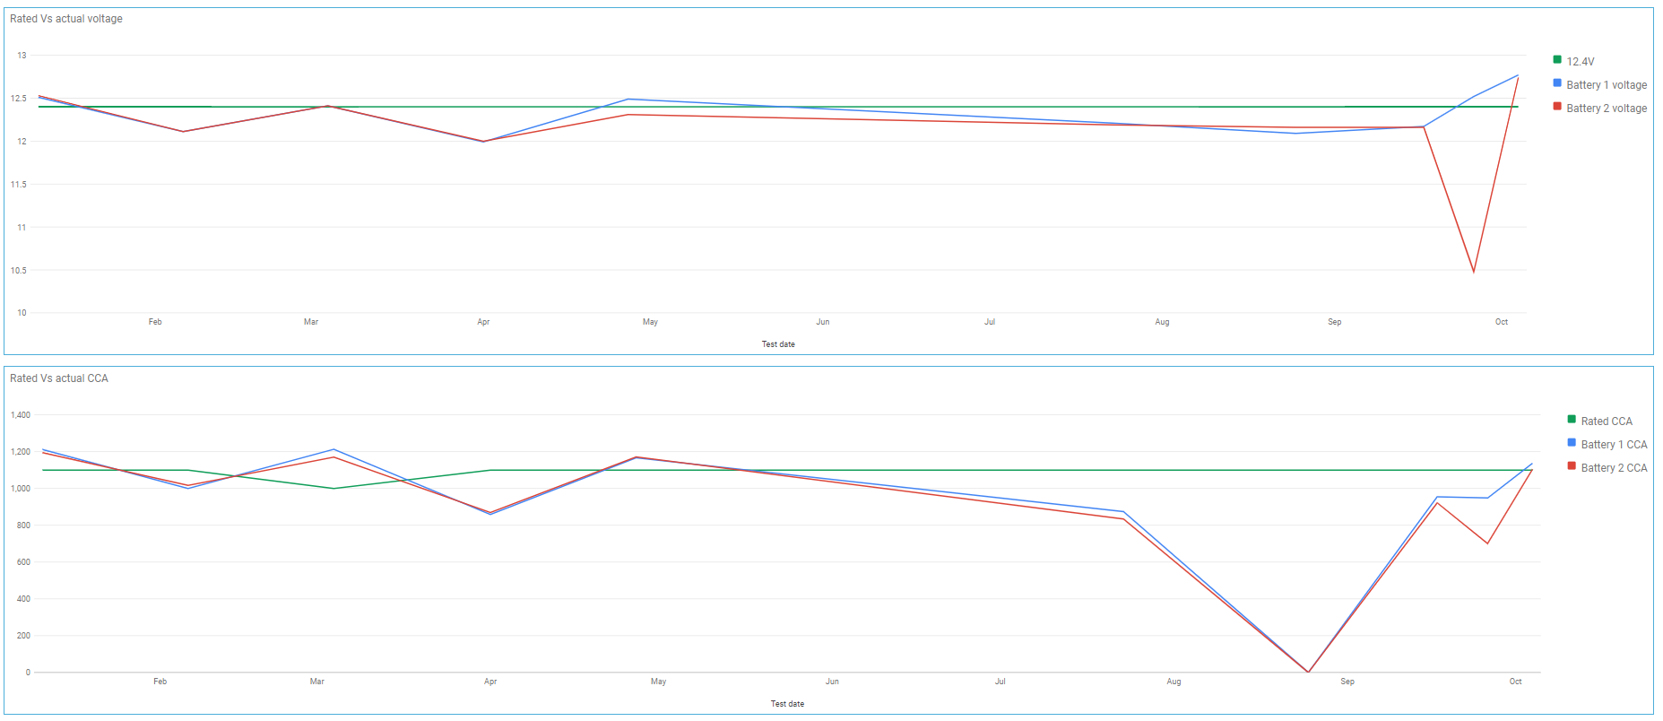
Example of Battery set out of balance over time
The above highlights a 24v battery set profile over a 10month period.
We can see from the voltage graph (top) that the battery voltage has continued to drop over the 10month period (through lack of maintenance charging) and that the CCA (bottom chart) shows a continued drop in battery capacity.
Highlighting over time that continued “out of balancing” of the 24v battery set, whereby both cca and voltage are not equalised, is seeing a continual reduction in performance, to the extent that the battery set fails prematurely, and if regular charging took place, could have reversed the impact and ensured the batteries remained serviceable for longer.

Slide 6
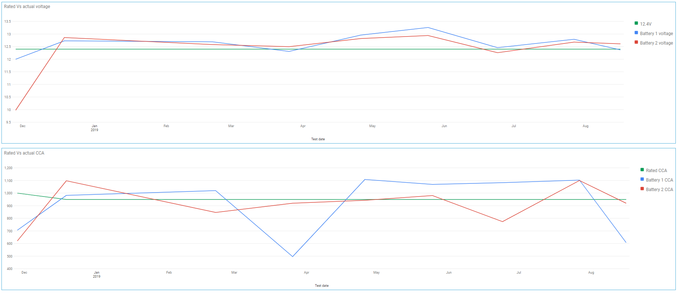
Example of Battery set out of balance over time
The above highlights a 24v battery set profile over a 10month period.
We can see from the voltage graph (top) that the battery voltage has been relatively stable (above 12.4v) however the cca of the batteries in the 24v have not been consistent with each other (out of balance).
The net impact has seen the battery performance fall over the 11 month period to a point whereby battery 1 has failed prematurely,
The following chart shows the individual test results recorded over the given period.

Slide 7
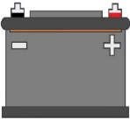
What is battery balancing ?
Battery imbalance is the biggest killer of batteries in 24, 36 and 48 volt systems.
Whenever 2 batteries, or more, is connected in series you will have a system which will need to be in balance. If not, it will result in premature battery failure
24V Battery charging will not help with battery balance
Natural individual 12V sulphation and lack of battery focus/maintenance will cause the battery pack to have different state of charge which only will be worse if charged with 24V (in which 98% of all HCV and industrial vehicles are)

Slide 8
Why Charge
2A
11.7A
2A
4A

Slide 9
Arriva buses
Several years ago Arriva buses in Denmark Identified that batteries were one of the main causes of their electrical breakdowns.
Over 50% reduction in battery related breakdowns
Similar reduction in battery replacement cost

Slide 10
Logitrans
Several years ago Logitrans in Denmark Identified that lack of balance in batteries were one of the main causes of their electrical breakdowns.
Over 50% reduction in battery related breakdowns
Similar reduction in battery replacement cost

Slide 11
What are the benefits of battery balancing ?
Longer service life
Increased reliability
Cost saving
Minimum downtime
Minimum customer complaints/warranty related issues
Minimizing the carbon footprint
Adding value to the Company´s sustainability program

